Slide 1
Step 1: Launch FoundationSWT
All CompUnit components execute within a container called Foundation. There are three implementations available:
  Foundation – executes as command-line application
  FoundationApplet – executes within a Browser
  FoundationSWT – executes as stand-alone application
For your project you will launch primarily as the FoundationSWT option. To make this a reality, you must create a run-time configuration; this will be useful also when it comes time to debug your component executions.
Select menu "Run --> Open Run Dialog...", select "Java Application" and request to create a "New launch configuration“. You will see the screen on the following page:

Slide 2
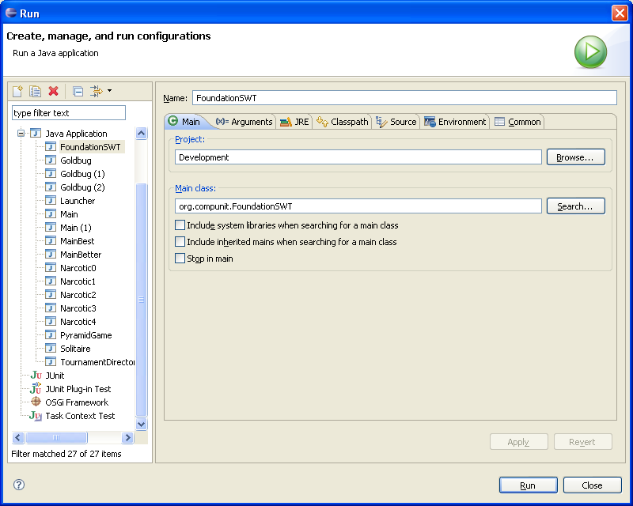
Enter “FoundationSWT” as the Name
Change Project to Development
Change Main class to “org.compunit.FoundationSWT”
Select “Arguments Tab” and move to the next page for instructions…..

Slide 3
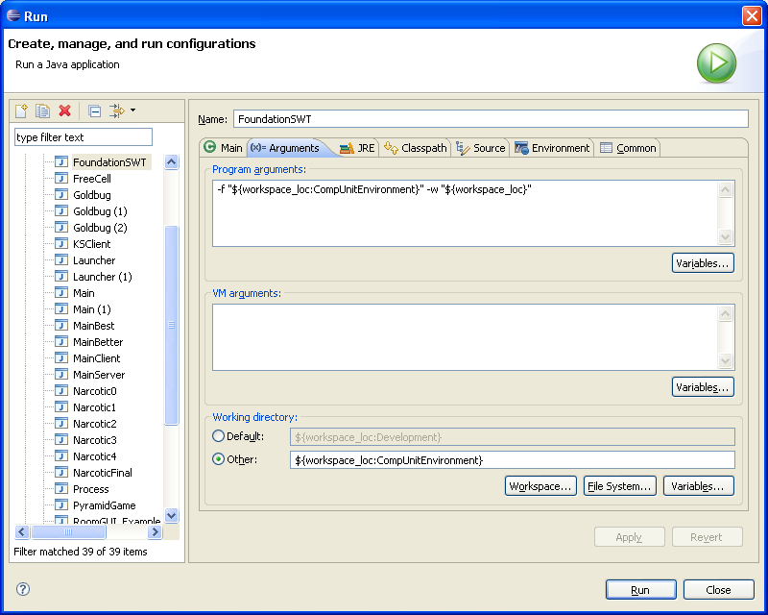
Enter as program arguments -f "${workspace_loc:CompUnitEnvironment}" -w "${workspace_loc}"
Change the Working directory to ${workspace_loc:CompUnitEnvironment}

